Slide 1

Statistics for Data Science

Slide 2
OUTLINE
Basic Statistics
Linear Regression

Slide 3
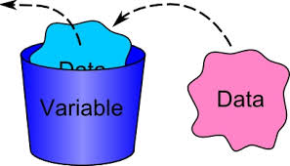
What is Statistics
Statistics is the study of the collection, analysis, interpretation, presentation, and organisation of data.
Being in the field of Machine Learning or Data Science, statistics concepts are very essentials ingredients to comprehend core Machine Learning Algorithms.
In statistics, a variable has two defining characteristics:
It describes an attribute that describes a person, place, thing, or idea. The value of the variable can "vary" from one entity to another.
For example, a person's hair color is a potential variable, which could have the value of "blond" for one person and "brunette" for another.

Slide 4
Qualitative vs. Quantitative Variables
Variables can be classified as qualitative (aka, categorical) or quantitative (aka, numerical).
In algebraic equations, quantitative variables are represented by symbols (e.g., x, y, or z).
For Example: Differentiation between qualitative and quantitative data is shown in right hand side figure.

Slide 5
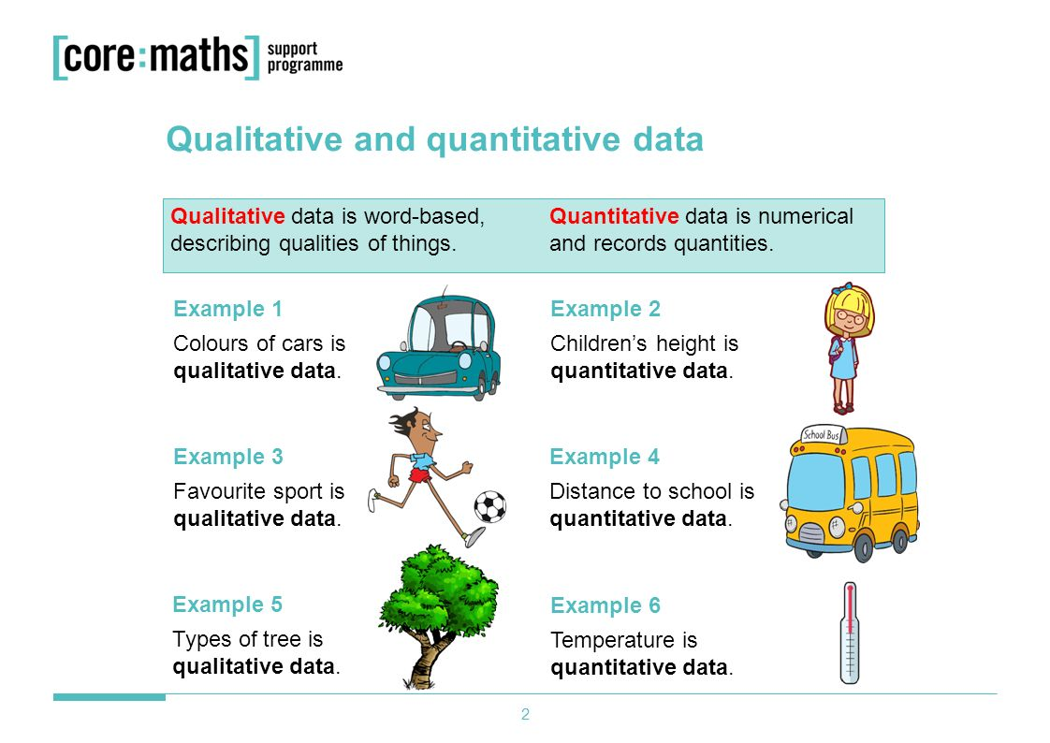

Slide 6
Discrete vs. Continuous Variables
If a variable can take on any value between its minimum value and its maximum value, it is called a continuous variable; otherwise, it is called a discrete variable.
Some examples will clarify the difference between discrete and continouous variables.
Suppose the fire department mandates that all fire fighters must weight between 150 and 250 pounds. The weight of a fire fighter would be an example of a continuous variable; since a fire fighter's weight could take on any value between 150 and 250 pounds.
Suppose we flip a coin and count the number of heads.
The number of heads could be any integer value between 0 and plus infinity. However, it could not be any number between 0 and plus infinity. We could not, for example, get 2.3 heads. Therefore, the number of heads must be a discrete variable.

Slide 7
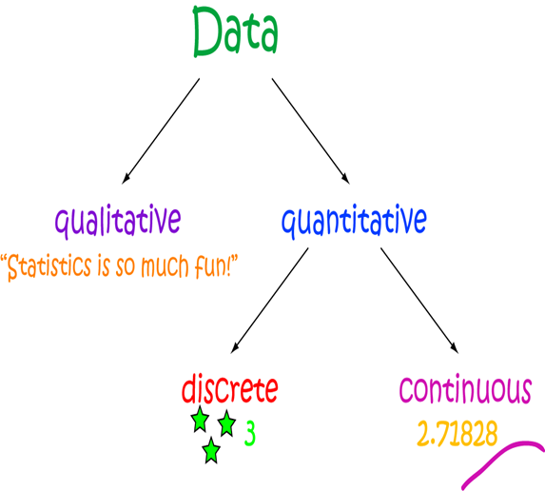

Slide 8
Univariate vs. Bivariate Data:
Statistical data are often classified according to the number of variables being studied.
Univariate data: When we conduct a study that looks at only one variable, we say that we are working with univariate data.
Suppose, for example, that we conducted a survey to estimate the average weight of high school students. Since we are only working with one variable (weight), we would be working with univariate data.
Bivariate data: When we conduct a study that examines the relationship between two variables, we are working with bivariate data.
Suppose we conducted a study to see if there were a relationship between the height and weight of high school students. Since we are working with two variables (height and weight), we would be working with bivariate data.

Slide 9
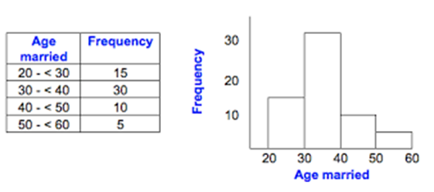
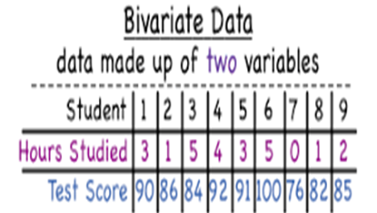
Univariate Data

Slide 10
Regression
Simple linear regression is a statistical method that allows us to summarize and study relationships between two continuous (quantitative) variables:
One variable, denoted x, is regarded as the predictor, explanatory, or independent variable.
The other variable, denoted y, is regarded as the response, outcome, or dependent variable. Because the other terms are used less frequently today,
we'll use the "predictor" and "response" terms to refer to the variables encountered .
Simple linear regression gets its adjective "simple," because it concerns the study of only one predictor variable.
In contrast, multiple linear regression, which we study later in this course, gets its adjective "multiple," because it concerns the study of two or more predictor variables.
Types of relationships
Before proceeding, we must clarify what types of relationships we won't study in this course, namely, deterministic (or functional)relationships. Here is an example of a deterministic relationship.

Slide 11
Deterministic or Functional Relationship
Here is an example of a deterministic relationship.
That is, if you know the temperature in degrees Celsius, you can use this equation to determine the temperature in degrees Fahrenheit exactly.
For each of these deterministic relationships.
This equation exactly describes the relationship between the two variables

Slide 12
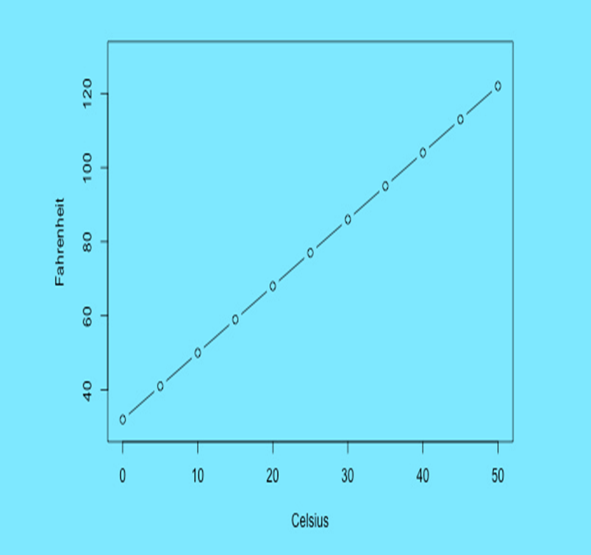

Slide 13
How to do we Calculate Simple Regression
Meal # | Tip amount ($)
1 | 5.00
2 | 17.00
3 | 11.00
4 | 8.00
5 | 14.00
6 | 5.00
Lets assume that you are a small restaurant owner or a very business minded server/waiter at a nice restaurant.
Tips are very important part of a waiter’s pay. Most of the time dollar amount of tip is related to the dollar amount of the total bill.
Question?
As a waiter or owner, you would like to develop a model that will allow you to make a prediction about what amount of tip to expect for any given bill amount. Therefore, one evening, you collect data for six meals

Slide 14
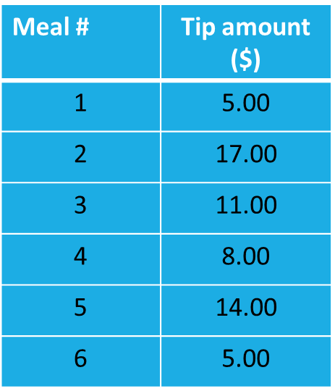

How might you predict the tip amount for future meals showing only this Data?
Only one variable tip amount

Slide 15
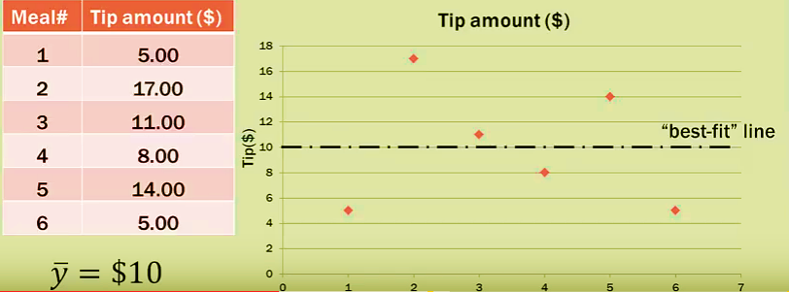
Possible Solution
Take the mean value value of y which is shown as y hat = $10
Other linear regression is about two variables but here we have only one variable.
If we have only one variable, the best prediction for other values is mean of dependent variable.

Slide 16
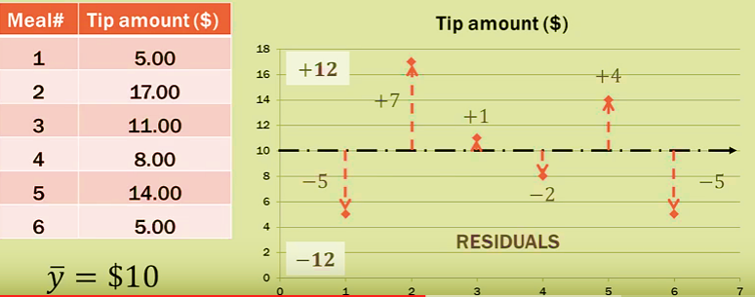
Goodness of Best fit Line
Data points in this model they don’t fall on $ 10 line, some are above and below it.
That shows how this line best fits on these observed data points.
We need to calculate the deviation from the mean points
Residuals (errors). Distances between the mean with respect to observed values are called residuals.

Slide 17
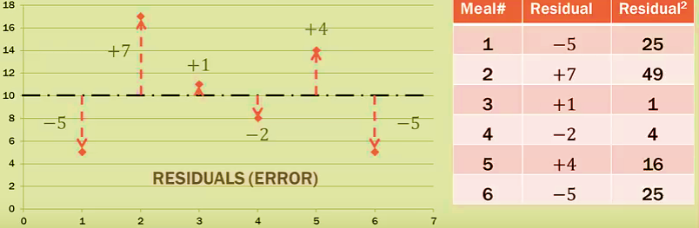
Square the Residuals (Error)
Why we square them?
To make them positive
Emphasize on larger deviations.
Where the sum of squared errors (SSE) is 120
The goal of linear regression is to minimize the sum of square residuals/errors.
If our regression model is significant, the regression line should fit the data. It will minimize the residuals.
120

Slide 18
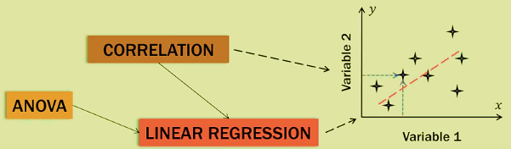
Bivariate aka two variable
Where the value one variable, is a function of other variable.
The value of y is function of x; y = f (x)
The value of the dependent variable, is a function of independent variable.
In regression, the whole idea is to find the best regression line which minimizes the sum of square residuals (error)

Slide 19
Some other examples of statistical relationships might include:
Height and weight — as height increases, you'd expect weight to increase, but not perfectly.
Alcohol consumed and blood alcohol content — as alcohol consumption increases, you'd expect one's blood alcohol content to increase, but not perfectly.
Vital lung capacity and pack-years of smoking — as amount of smoking increases (as quantified by the number of pack-years of smoking), you'd expect lung function (as quantified by vital lung capacity) to decrease, but not perfectly.
Driving speed and gas mileage — as driving speed increases, you'd expect gas mileage to decrease, but not perfectly.

Slide 20
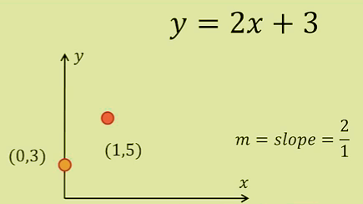
Algebra of Lines
How regression line is stated:
Slop: intercept form of a line
y = mx + b ( line equation)
X = random variable
m = slope of the line- rise/run
b = y- intercept ( crosses y-axis)
Property: y- intercept is where x = 0
y= 2(0) +3
y=3
(0,3)
Where x =1,
y= 2(1) +3
y=5 (1,5)

Slide 21
Okay, so let's study statistical relationships between one response variable y and one predictor variable x!
Since we are interested in summarizing the trend between two quantitative variables, the natural question arises — "what is the best fitting line?"
At some point in your education, you were probably shown a scatter plot of (x, y) data and were asked to draw the "most appropriate" line through the data. Even if you weren't, you can try it now on a set of heights (x) and weights (y) of 10 students, (student_height_weight.txt).
Looking at the plot below, which line — the solid line or the dashed line — do you think best summarizes the trend between height and weight?

Slide 22
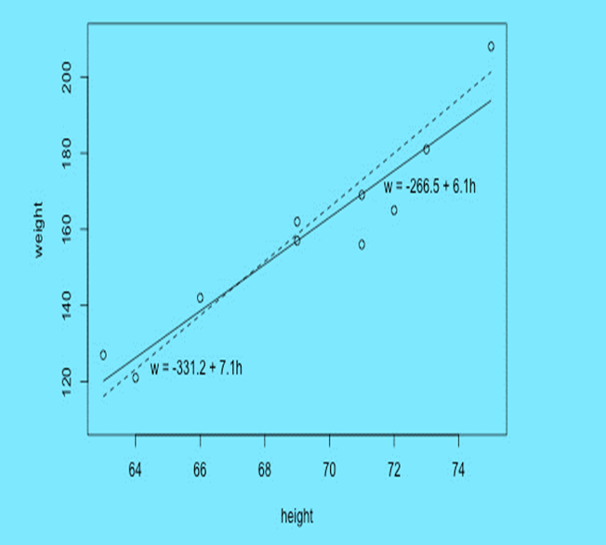
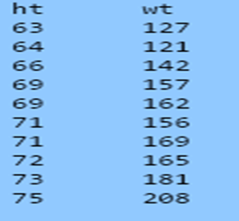

Slide 23
The Least Square Method:
Similar Model for Tips for Service we learnt:
Previously we had only tip variable now we have bill amount it means two variables.
Here, we want to know what degree the tip amount can be predicted by bill. So the tip is the dependent, bill is the independent variable.

Slide 24
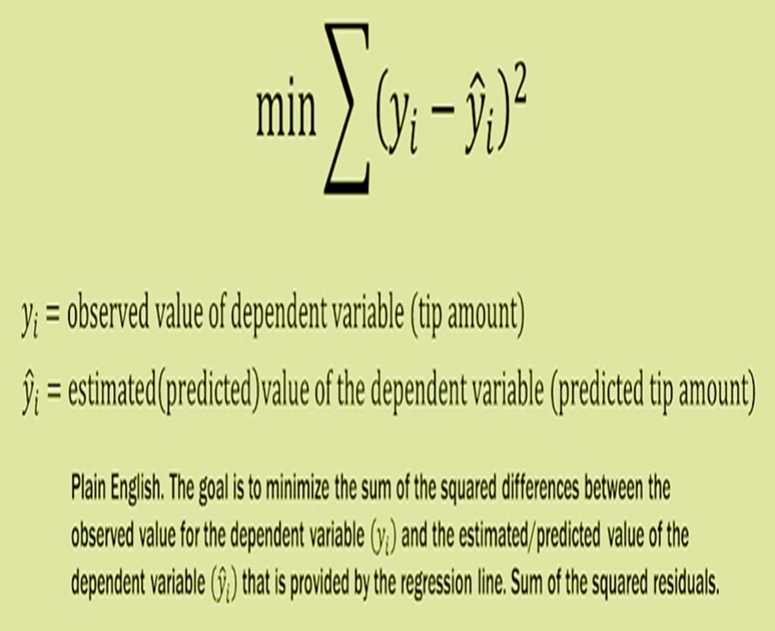

Slide 25
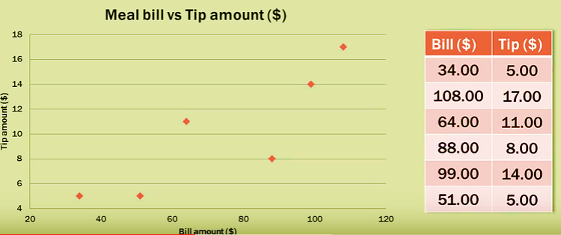
Scatter Plot

Slide 26
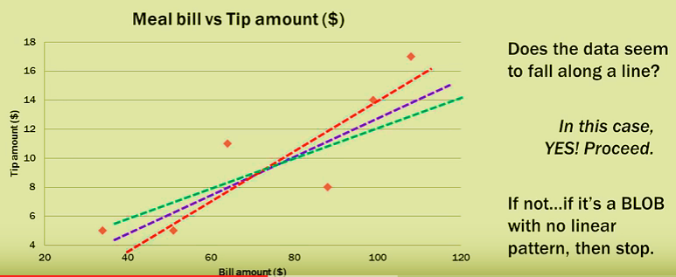
Does This Data Seems to fall on Line?

Slide 27
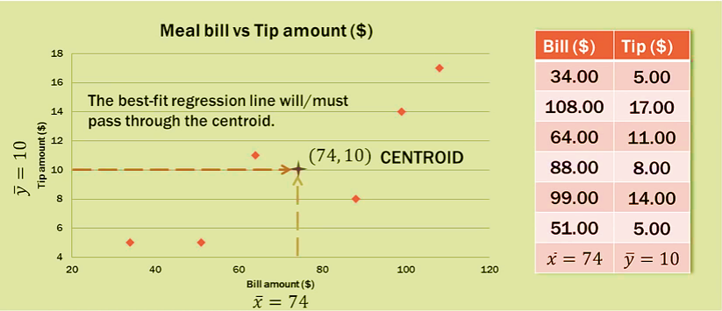
What is Best fit Regression Line?

Slide 28
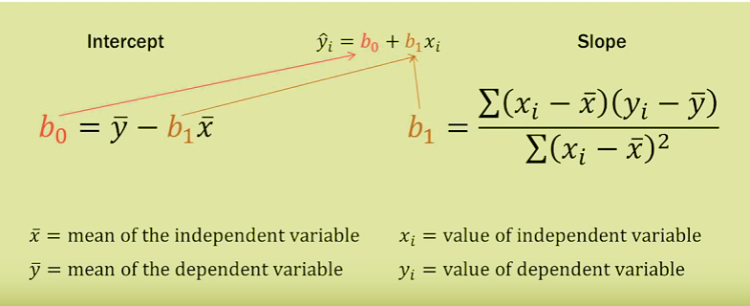
Calculation of Intercept and Slope

Slide 29
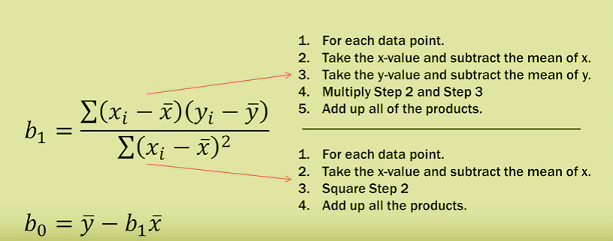
Steps for Calculation

Slide 30
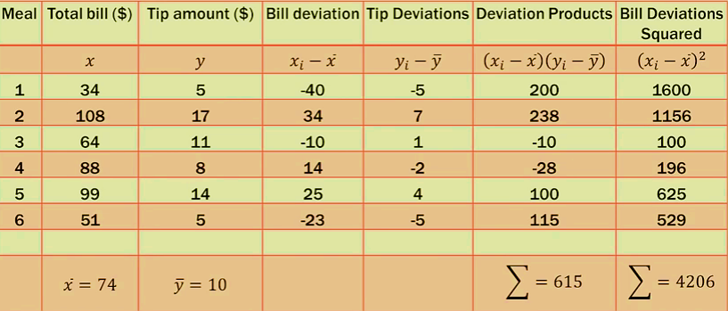
Tabular Results

Slide 31
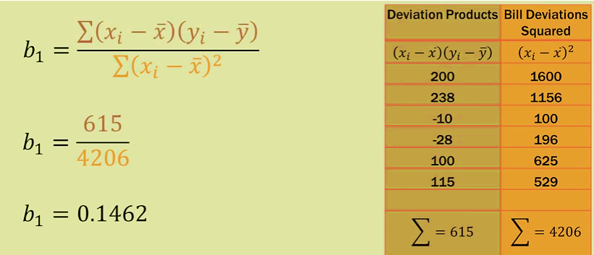
B₁ Slope calculation

Slide 32
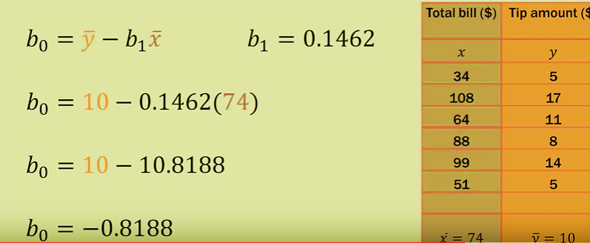
B₀ y -Intercept

Slide 33
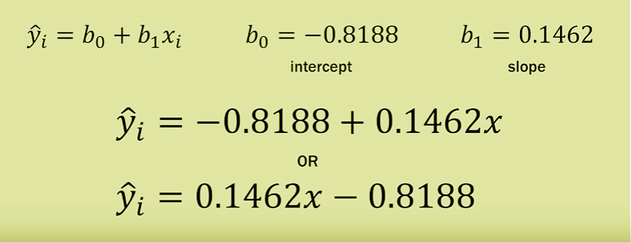
Regression Line

Slide 34
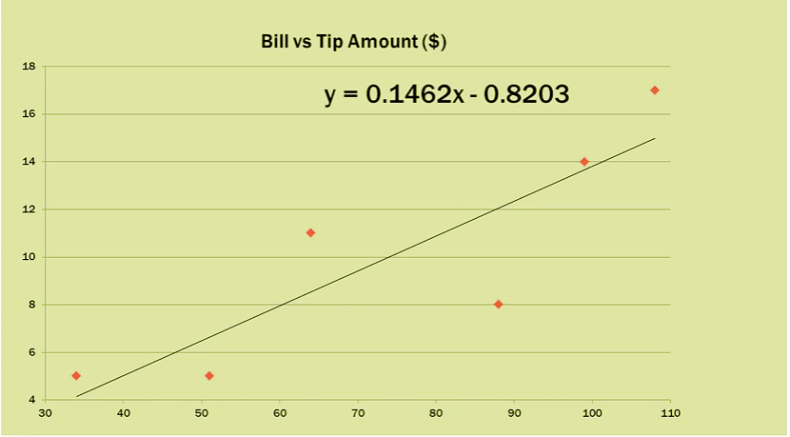
Scatter Plot

Slide 35
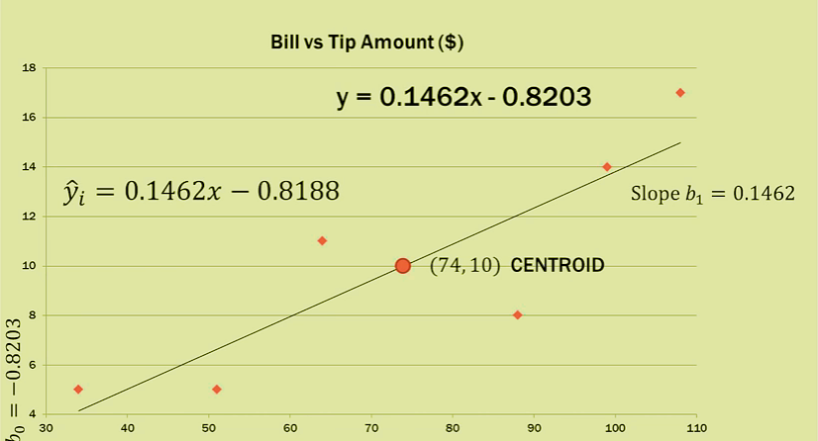
Scatter Plot

Slide 36
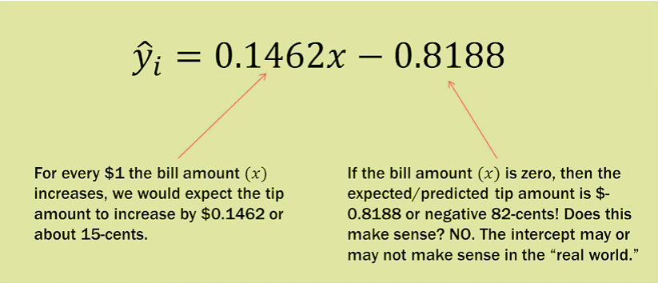
Interpretation

Slide 37
Thank You

